Slide 1
Starbucks FOOD’s
visualization for the nutrition of Food item’s (max calories, max fat(g) and max carbs(g)

Slide 2


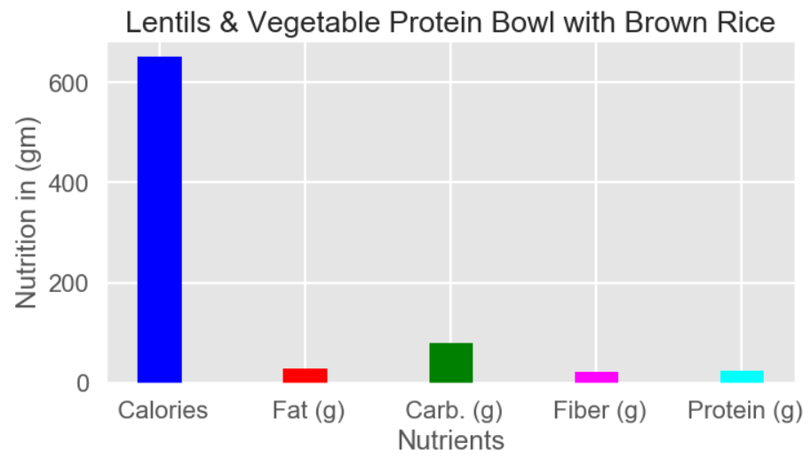

Slide 3
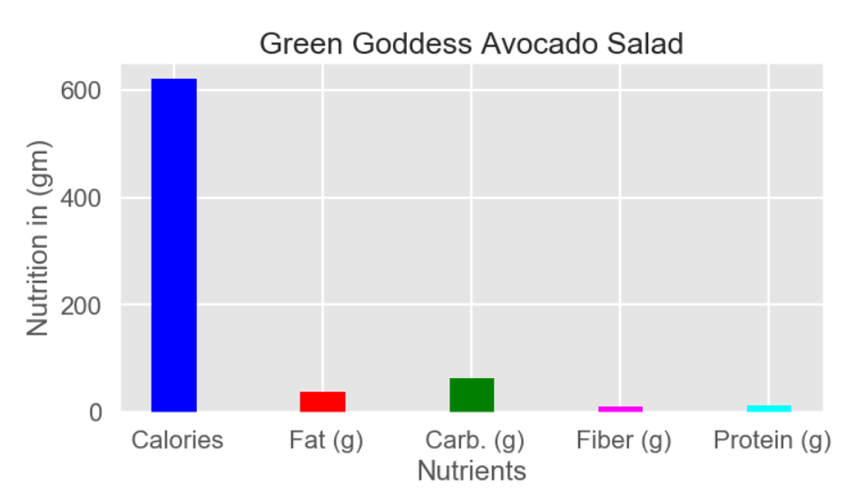

Slide 4
